Slide 1

The Effects of Natural Disasters on Communities
Hurricane Ike(2008) on City of Galveston, TX
&
Louisa County VA Earthquake (2011) on Louisa County, VA
Oleg Mironov | Amy Reynolds
Mariam Hassan | Kundyz Smith
Notes:
Kundyz can you hear us? Mariam can you hear anything?

Slide 2
How are communities affected by natural disasters?
Local Enforcement ‘Agencies’ (police stations)
Crime Data
Galveston, TX and Louisa County, VA
Census Statistics
Population Data
Median Household Income Data
Conclusion
Q/A
Notes:
Found list of natural disasters on Wikipedia that showed depth and size of natural disaster
Cross Referenced those with agencies that participated

Slide 3
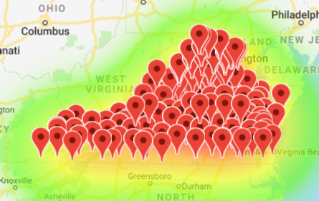
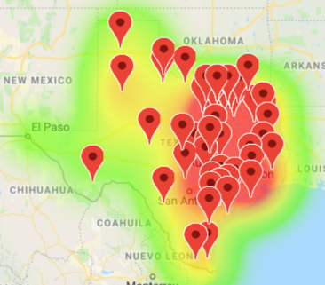
Agencies
Sources
CSV from FBI National Incident-Based Reporting System (NIBRS)
Analysis
TX agencies in 2008
All – 1099
After drop null lat/long – 1094
Participating – 76
VA agencies in 2011
All VA– 455
After drop null lat/long – 452
All VA Participating – 410
Findings
Data available for
Galveston – Hurricane Ike 2008 &
Louisa County – East Coast Earthquake 2011

Slide 4
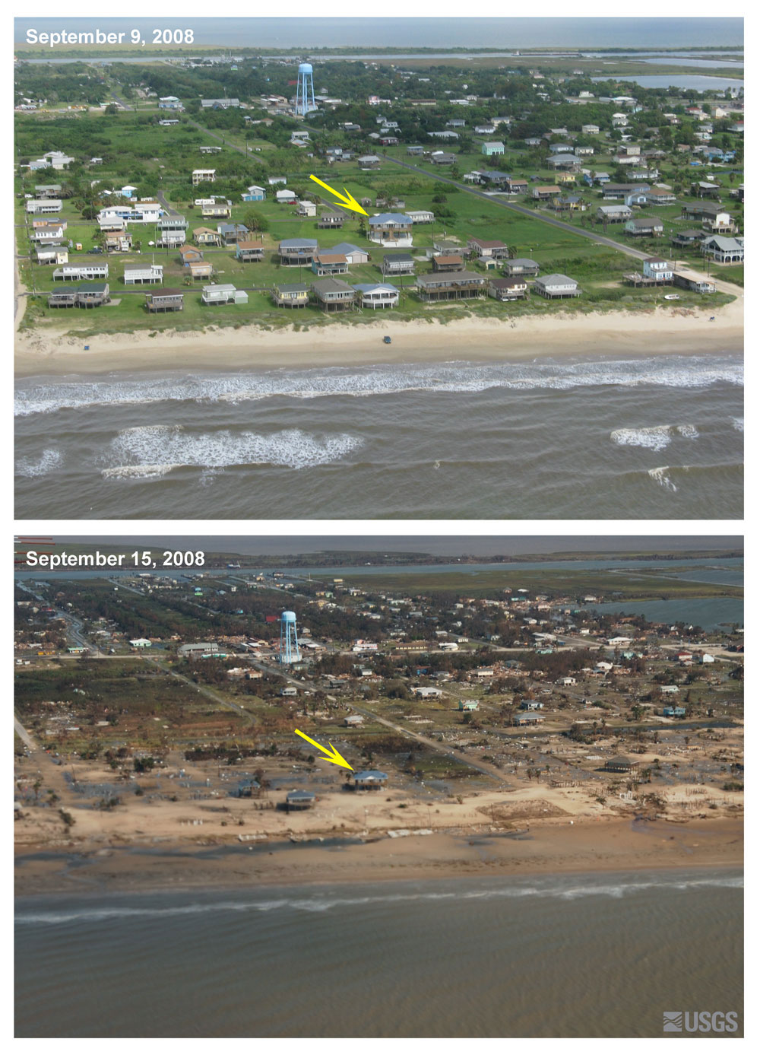
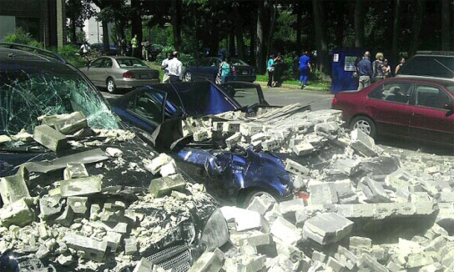
Left Top – Galveston Island before Hurricane Ike
Left Bottom – Galveston Island after Ike
Right – Louisa County , VA after 5.8 East Coast Earthquake 2011

Slide 5

Crime
API pull from FBI National Incident-Based Reporting System (NIBRS)
Galveston, TX
Hurricane Ike
Louisa County, VA
East Coast Earthquake in 2011
Originally started with 3.64 million lines
Filtered to 46 K by selecting records reported by specific police station (Galveston and Louisa counties).
Findings:
Galveston crime rate dropped immediately on the date of disaster and stayed below average in the two years post hurricane
Louisa county crime rate dropped on the date of disaster, however it exceeded the average crime rate for the two years following the earthquake

Slide 6
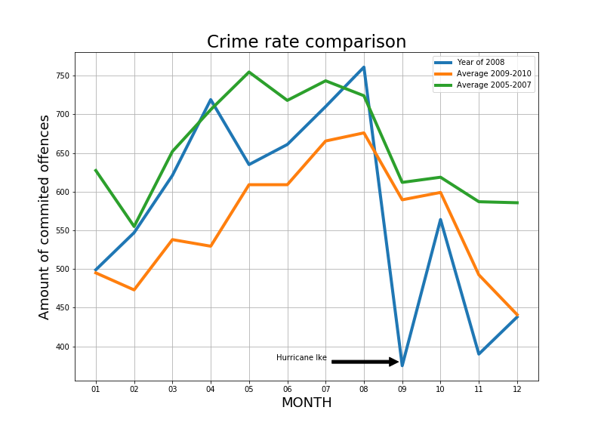
Galveston, TX

Slide 7
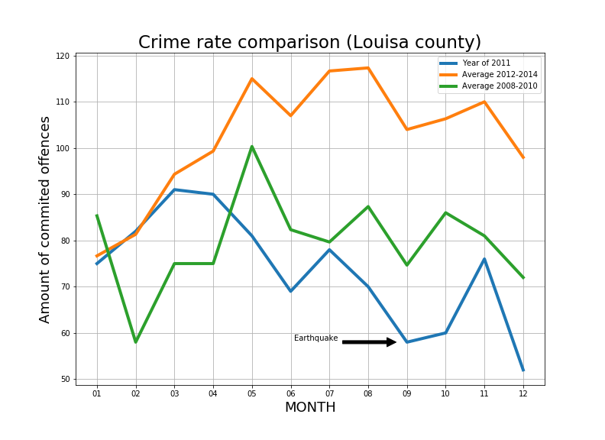
Louisa County, VA

Slide 8

Population
Source
Census Data API.
Analysis
API pulls were specific to exact needs
Removed State and County because that information was provided in different columns.
We have left the only columns we needed to graph our plots such as Population, County/City, State, and Year.
Findings
Galveston
Population 2006 approx. 52,000
Population in 2008 dropped to 48,500.
By 2011, the population was approx. 47k and then in 2012 population began to regulate
Virginia
Population was unaffected and continued to rise although there seemed to be a slight plateau in 2011
Notes:
Where did data come from?
Both data (population estimate for Galveston city and Louisa county) came from Census Data API.
How much start with?
Pulling Census data was pretty straight forward process with a few issues; thus, we had obtained exactly what we needed. The websites contained information on how to pull exact data and reference to variables. The variables we have gather are: Population estimate, Geographic name, Place based on FIPS codes, Dates, and States.
How much removed? Why?
After further processing the data, we have removed some variables such as State and County because that information was provided in different columns.
What is left?
We have left the only columns we needed to graph our plots such as Population, County/City, State, and Year.

Slide 9
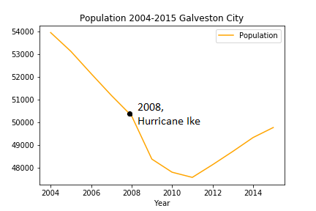
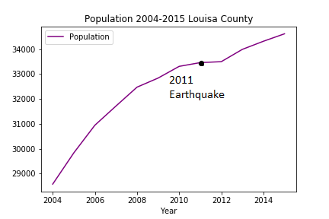
Population Changes 2004 - 2015

Slide 10
Median Household Income
Source
Census data website using an API key and exported to Excel
Analysis
Accessed data on the county, state, dates, median household income and median household income margins of error.
‘State’ and ‘County’ were removed as that was already located on the chart, leaving only the incomes, dates, and location.
Findings
Galveston – increased post hurricane
Louisa stagnated and then increased
Notes:
1. Where Did The Data Come From?
The data for the median household income (Louisa County, VA and Galveston, TX) were obtained through the Census data website using an API key.
2. How much data to start with?
I was able to access data on the county, state, dates, median household income, median household income margins of error.
3.How much was removed, and how much is left?
I removed State and County data as that was already located on the chart, leaving only the incomes, dates, and location.
The median household income in Galveston, Texas following Hurricane Ike went well above the expected trend for the following years up until 2015.
As for Louisa County, VA the median household income stayed relatively stagnant in the year following and increased slightly until 2015.

Slide 11
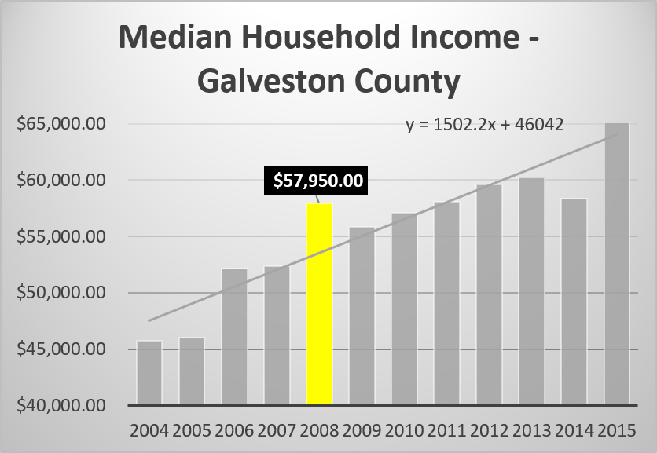
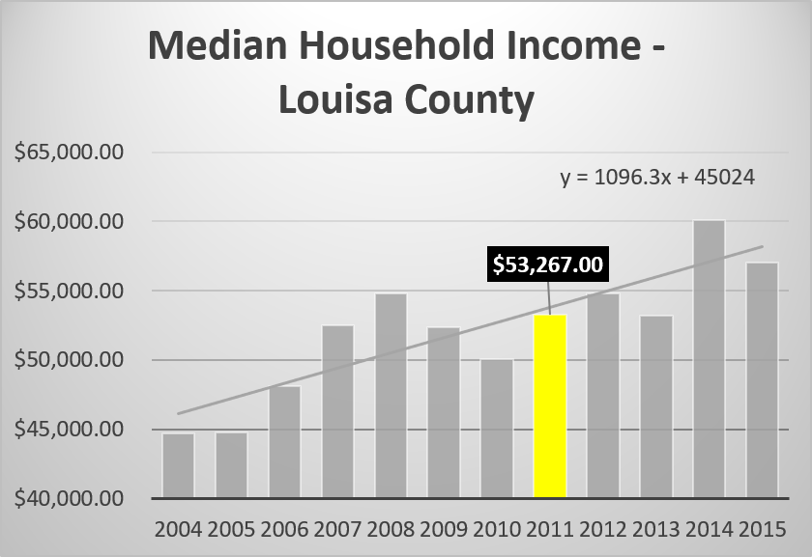
Income Changes 2004 - 2015

Slide 12
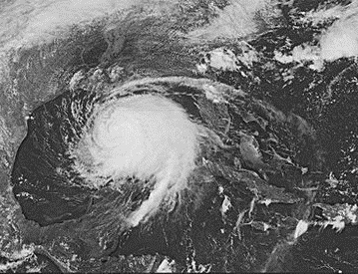
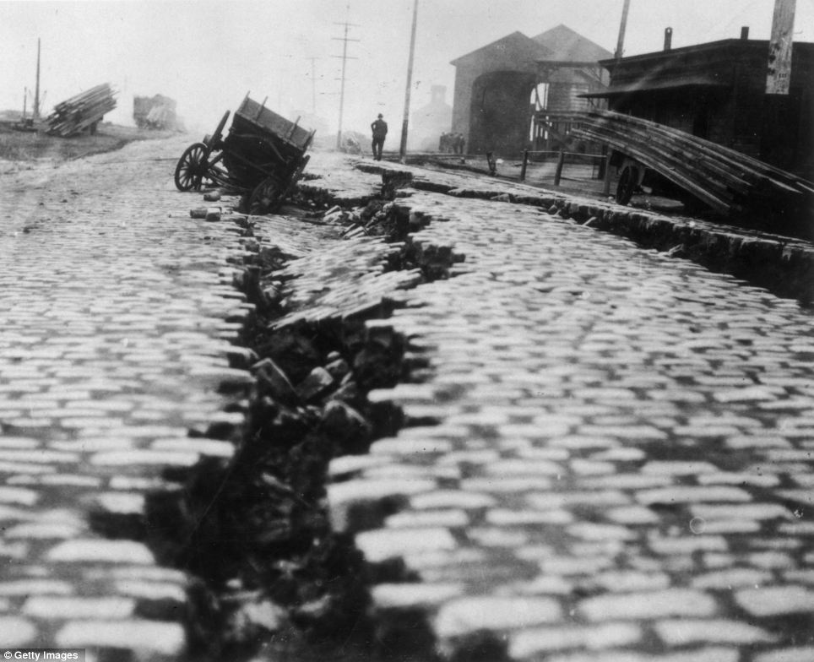
Conclusion
Virginia is more compliant with the FBI’s new crime reporting system than Texas
According to the Houston Chronicle there was an increased police presence which could have deterred crime.
Population In Galveston has been steadily decreasing starting before and after Hurricane Ike which could also have contributed to crime decline.
The median household income in Galveston following Hurricane Ike went well above the expected trend for the following years up until 2015.
The East Coast Earthquake was rare for Virginia. Before this quake, the largest on record for Virginia was 4.8 in 1875
The population and crime increased in Louisa County following the earthquake.
The median household income in Louisa County stayed relatively stagnant in the year following and increased slightly until 2015.

Slide 13


Slide 14
Sources
FBI crime data:
https://crime-data-explorer.fr.cloud.gov/api
Census Data:
https://api.census.gov/data/
Google Maps:
https://cloud.google.com/maps-platform/
News Article about police activity post Ike
https://www.chron.com/news/hurricanes/article/Looters-think-twice-as-police-up-patrol-arrest-1591018.php

